Slide 1



AR-oom: Build your home
Ain Shams University
Faculty of Computer and Information Sciences
Department: Software Engineering
Graduation project SWE 2021-2022

Slide 2
Team:
Doctor: Dr. Yasmine Afify
TA: Dr. Naglaa Fathy
Ahmed Lotfy
Ahmed Yasser
Omar Essam
Omar Sheshtawy
Mohamed Zaki
Ziad Hassan

Slide 3
Table of contents
What is Augmented Reality?
Problem Statement
Objective
What’s AR-oom?
System Architecture
Functional Requirements
Non-functional Requirements
Use Case Diagram
Class Diagram
Challenges
Algorithms and Techniques
Demo

Slide 4
1-What’s Augmented Reality?
Augmented reality (AR) involves overlaying visual, auditory or other sensory information onto the world in order to enhance one's experience.
Used in Education and Fitness.

Slide 5
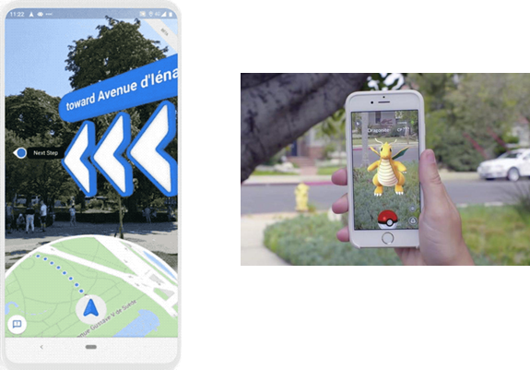
Examples on AR
•Pokémon Go
•Google maps

Slide 6
2- Problem statement
How to visualize different furniture models with a variety of colors in the current environment?
Notes:
Buying furniture has always been an exhausting task, whether you bought a chair, sofa, bed or even a carpet and later find out that they don't fit, not suitable for the surroundings or that their size is not what you imagined. You're faced with a dilemma. Either you return the goods (if possible) and search once again, or keep it and live with its burden. However, by then you would have put in a lot of time, effort and money.
Nowadays, furniture come in so many different shapes, colors and sizes and so do houses. People now have to choose from a very wide variety of choices but how would they make the decision without seeing their choices in real physical world?

Slide 7
3- Objective
Facilitating the process of trying more than one piece of furniture together and check how they all look like. Giving an in-store experience for the users.
Visualizing home furniture through the lens of user’s mobile phone camera and right on their screen, helping users decide if it's suitable or not, and what furniture will fit best in their space without any cost or effort.

Slide 8
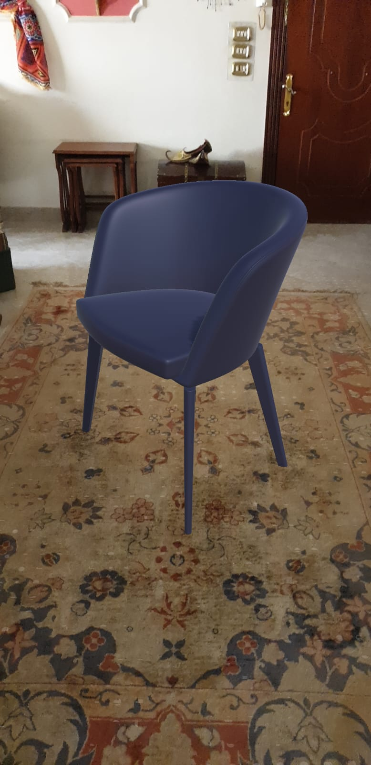
4- What’s AR-oom?
AR-oom is a Unity-based application that uses ARCore SDK on android OS utilizing the AR technologies in simulating the process of trying out different pieces of furniture in the same room.

Slide 9
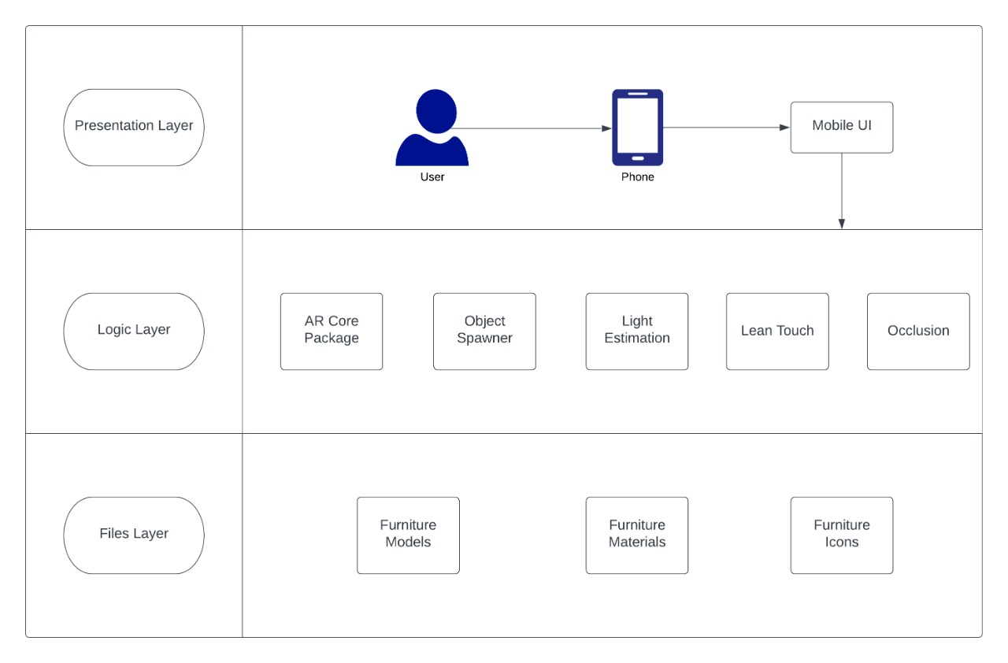
5- System architecture
Notes:
Animate slide.

Slide 10
6- Functional requirements
Visualize different furniture pieces using AR into the real world.
Provide a list of furniture models to choose from.
Categorize furniture models into different categories.
Edit models’ color.
View the models’ dimensions.
Manipulate models.
Clear scene.
Reset scene.
Capture screenshots of the furniture models.

Slide 11
7- Non-functional requirements
User friendly interface
Quick response to user commands
Improved performance.
AR focused user experience.

Slide 12
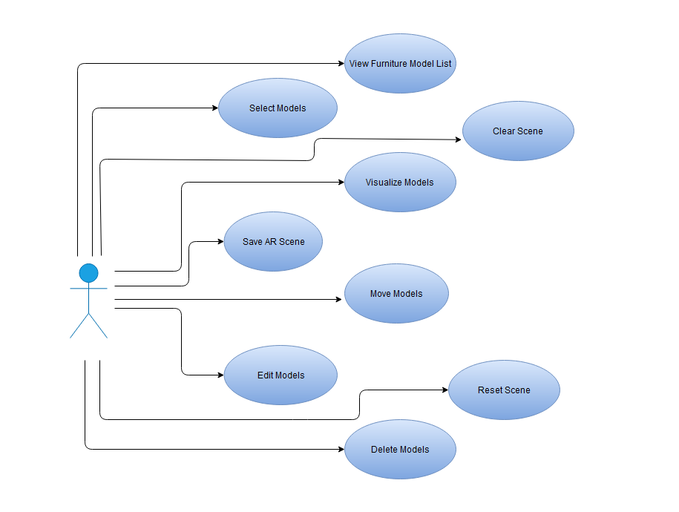
8- Use Case diagram

Slide 13
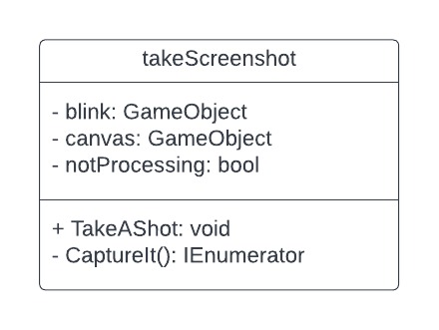
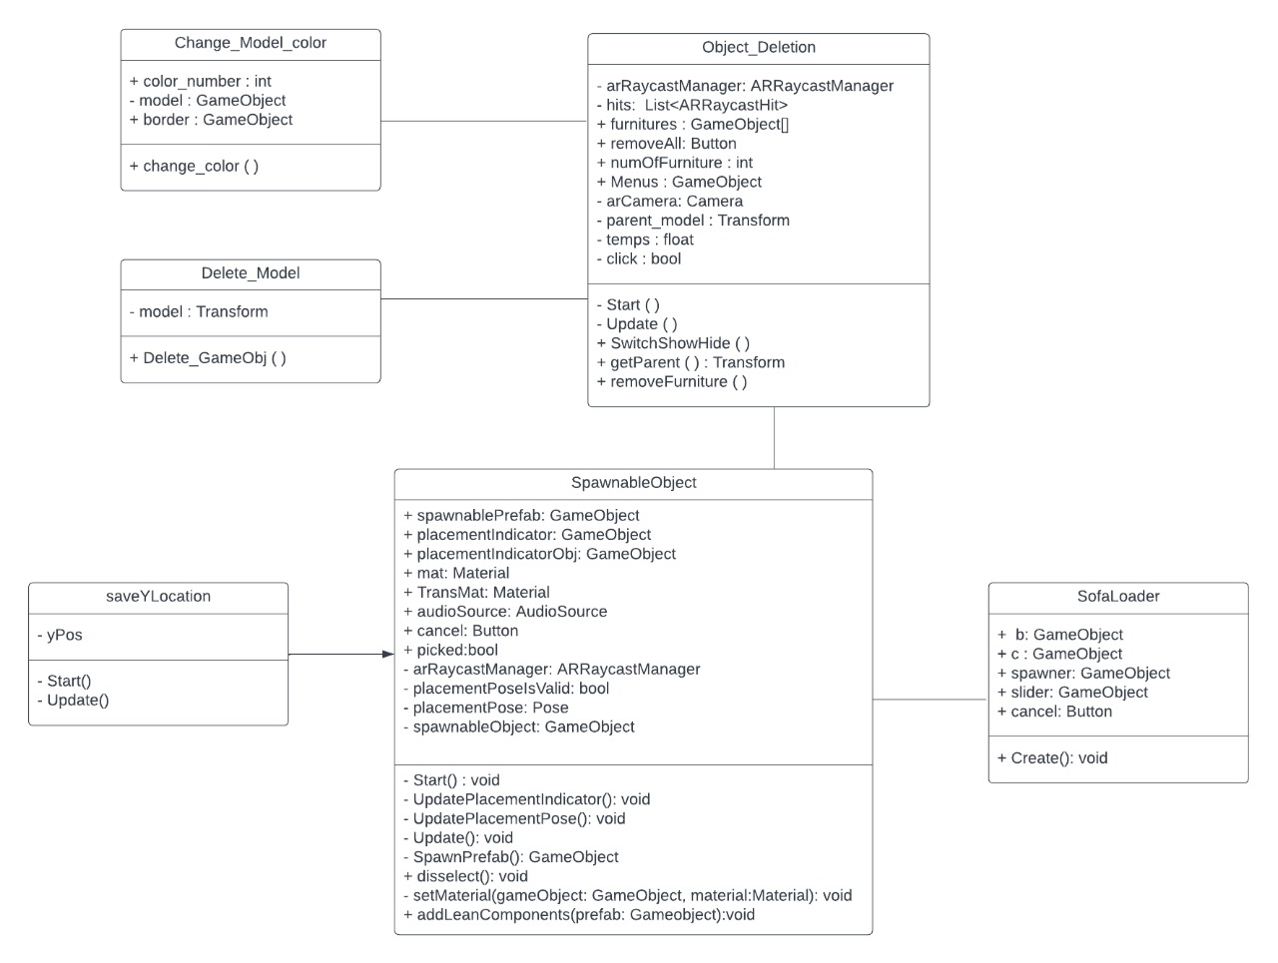
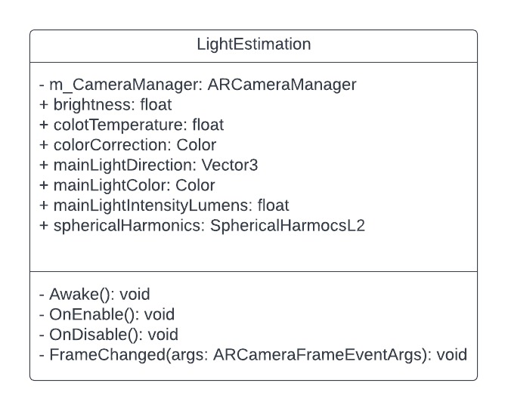
9- Class Diagram

Slide 14
10- Challenges
The discrepancy between the sizes of the 3D models available was too big and sometimes unrealistic. Solution adopted: Preprocessing of the models was done using Blender.
Lean touch translation moved the models in the y-axis ignoring gravity.. Solution adopted: A script was written to restrict the movement of models on the y-axis.
Models added were visible through real objects in the scene. Solution adopted: Occlusion property was added to the models.
Models overlapped when multiple ones were added. Solution adopted: Box collider component was added to the models to detect collision and handle it.
Models didn’t look realistic in the scene. Solution adopted: Light estimation was used to change the color and intensity of the light rendered on the model.

Slide 15
11- Algorithms and techniques
Plane detection:
Motion Tracking
Scene Understanding
Light Estimation
Notes:
At first stage – Motion Tracking – each smartphone combines visual data coming from RGB camera sensor (at 60 fps) and motion data coming from accelerometer and gyroscope sensors (at 1000 fps) to compute a position of a high-contrast feature points using parallax formula. That information allows ARCore and ARKit get a position and orientation of a virtual camera in six degrees of freedom (6 DoF).
The next stage – Scene Understanding – helps ARCore and ARKit understand where several feature points (a.k.a. sparse point cloud) are coplanar – thus, letting a smartphone find out where a detected plane will be.
The last ARCore's stage is Light Estimation and the last ARKit's stage is Rendering (you don't even need to import SceneKit because ARKit contains all the necessary SceneKit's classes – check this out).

Slide 16
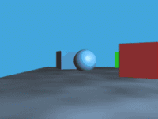
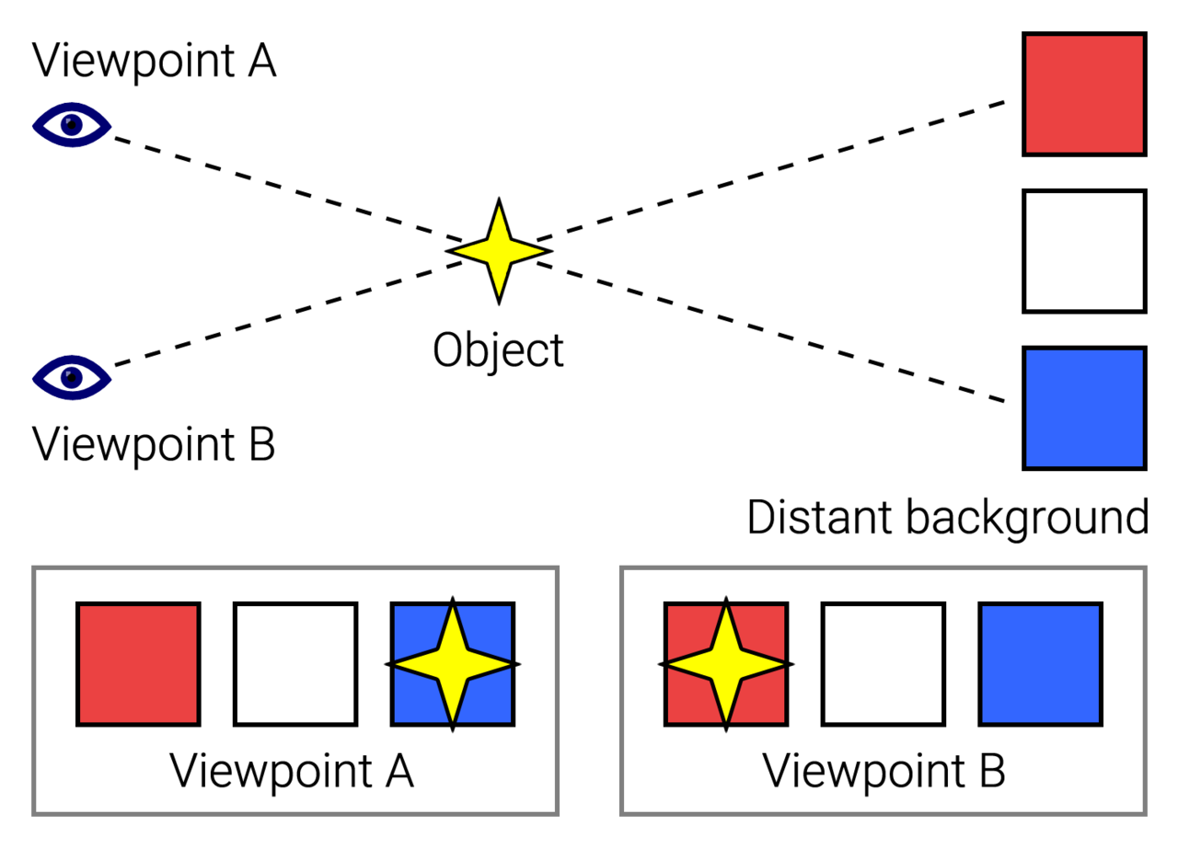
11- Algorithms and techniques
Parallax Formula:
Notes:
At first stage – Motion Tracking – each smartphone combines visual data coming from RGB camera sensor (at 60 fps) and motion data coming from accelerometer and gyroscope sensors (at 1000 fps) to compute a position of a high-contrast feature points using parallax formula. That information allows ARCore and ARKit get a position and orientation of a virtual camera in six degrees of freedom (6 DoF).
The next stage – Scene Understanding – helps ARCore and ARKit understand where several feature points (a.k.a. sparse point cloud) are coplanar – thus, letting a smartphone find out where a detected plane will be.
The last ARCore's stage is Light Estimation and the last ARKit's stage is Rendering (you don't even need to import SceneKit because ARKit contains all the necessary SceneKit's classes – check this out).

Slide 17
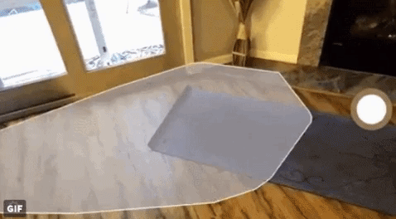
11- Algorithms and techniques
Plane detection:
Notes:
At first stage – Motion Tracking – each smartphone combines visual data coming from RGB camera sensor (at 60 fps) and motion data coming from accelerometer and gyroscope sensors (at 1000 fps) to compute a position of a high-contrast feature points using parallax formula. That information allows ARCore and ARKit get a position and orientation of a virtual camera in six degrees of freedom (6 DoF).
The next stage – Scene Understanding – helps ARCore and ARKit understand where several feature points (a.k.a. sparse point cloud) are coplanar – thus, letting a smartphone find out where a detected plane will be.
The last ARCore's stage is Light Estimation and the last ARKit's stage is Rendering (you don't even need to import SceneKit because ARKit contains all the necessary SceneKit's classes – check this out).

Slide 18
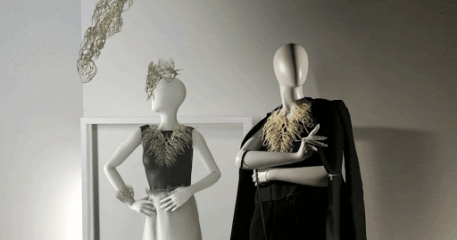
11- Algorithms and techniques (cont.)
Light estimation: Sensors of the mobile device capture the light intensity and color of the environment. These readings are applied to the directional light to affect the models in the scene.

Slide 19
11- Algorithms and techniques (cont.)
Lean Touch Asset
Lean Touch
Lean Select
Lean Manipulation
Notes:
Lean Touch: it will convert all mouse and touch data into easy to use data.
Lean Select: This component makes this GameObject selectable
Lean Manipulation: use the wanted manipulation component we want

Slide 20
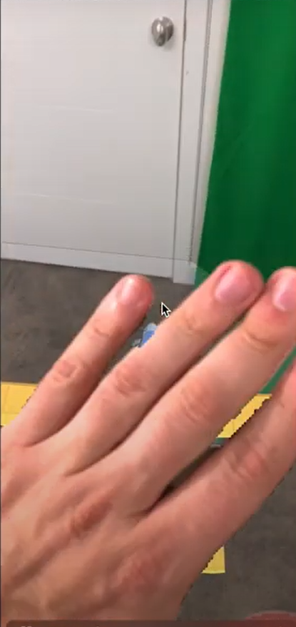
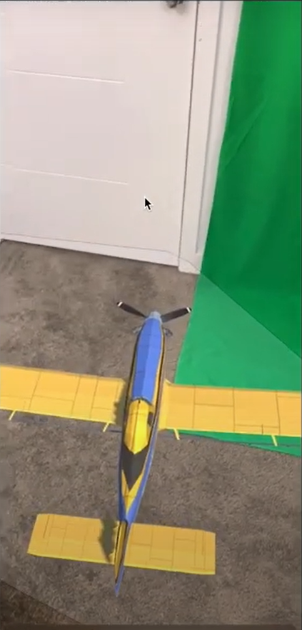
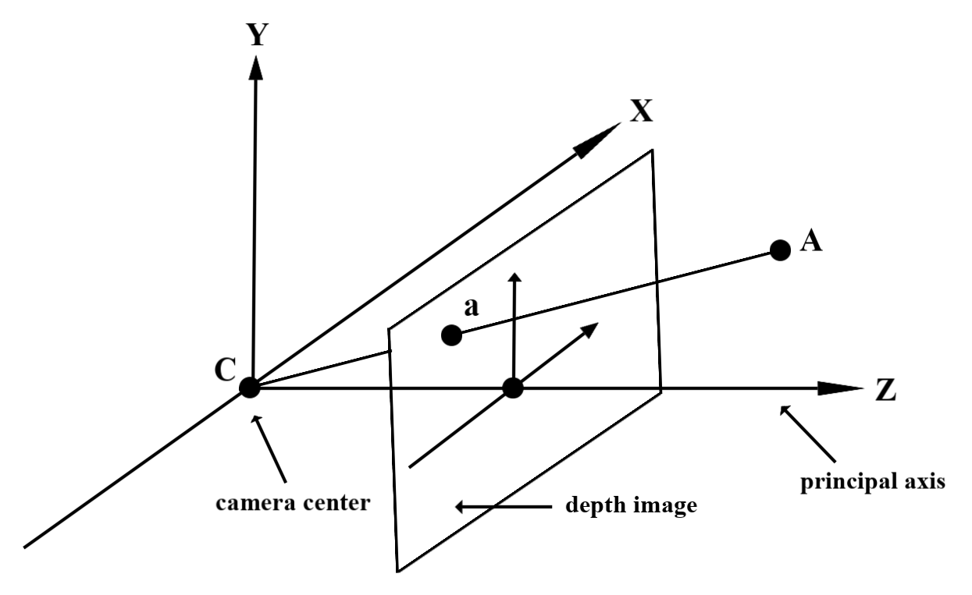
11- Algorithms and techniques (cont.)
Occlusion:
Notes:
Given point A on the observed real-world geometry and a 2D point a representing the same point in the depth image, the value given by the Depth API at a is equal to the length of CA projected onto the principal axis. This can also be referred as the z-coordinate of A relative to the camera origin C. When working with the Depth API, it is important to understand that the depth values are not the length of the ray CA itself, but the projection of it.

Slide 21
12- Demo

Slide 22
Questions?

Slide 23
Thank you!

